Slide 1




Career Assistant Chatbot
Miles A. Peña
Notes:
Hello everyone! Today, I'll be introducing you to the Career Assistant Chatbot, an AI-powered tool designed to help individuals with career development. This chatbot leverages artificial intelligence to provide personalized guidance on career paths, required skills, certifications, and much more.

Slide 2

What is the career assistant chatbot?
An AI-powered chatbot designed to help users with career planning.
Provides guidance on career paths, required skills, and certifications.
Uses OpenAI’s fine-tuned GPT model to offer personalized advice.
Notes:
The Career Assistant Chatbot is an AI-driven tool designed to assist users in making informed career decisions. It offers guidance on various career paths, provides information on certifications, and helps users understand what skills are needed for different jobs. This chatbot is powered by OpenAI’s GPT model, which has been fine-tuned to provide career-specific responses. Instead of searching through multiple resources, users can simply ask career-related questions and receive instant, AI-generated insights.

Slide 3
How it works
Trained on a dataset of career-related questions and expert responses.
Fine-tuned using OpenAI’s GPT-3.5 model to improve accuracy.
Accepts user queries and generates insightful career advice in real-time.
Notes:
So, how does this chatbot work? First, it has been trained on a carefully curated dataset that includes real-world career-related questions and expert answers. The chatbot uses a fine-tuned version of OpenAI’s GPT-3.5 model, meaning it has been specifically adapted to focus on career-related topics. When a user inputs a question, the chatbot processes the query, references its training data, and generates an insightful response in real time. This makes it an easy and accessible tool for anyone looking to improve their career prospects.

Slide 4

Key features
Provides career development advice and guidance.
Suggests relevant certifications and skills for different careers.
Helps with resume tips and interview preparation.
Answers questions in real-time using a fine-tuned AI model.
Notes:
The Career Assistant Chatbot comes with several powerful features:
It provides tailored career advice for different industries and job roles.
It suggests relevant certifications based on your desired career path.
It offers resume tips and interview preparation guidance to help users land jobs.
And most importantly, it responds in real-time, making it a quick and efficient career planning tool.

Slide 5
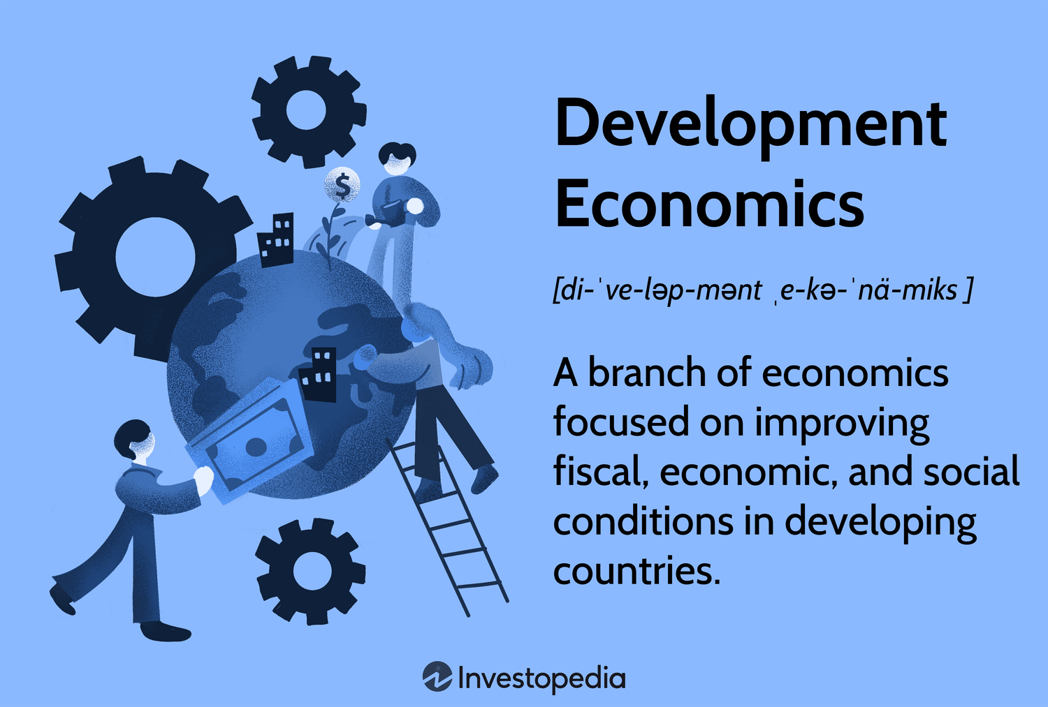
Who Can Benefit?
Students exploring career paths.
Job seekers looking for industry insights.
Professionals aiming for career growth.
HR professionals assisting employees with career development.
Notes:
This chatbot is designed for a variety of users:
Students who are exploring career options and need guidance on the skills required for different fields.
Job seekers who want advice on certifications and resume improvements.
Professionals looking for career advancement strategies.
HR professionals who assist employees in career development and upskilling. Essentially, anyone looking to advance their career or gain clarity on their career goals can benefit from this tool.

Slide 6
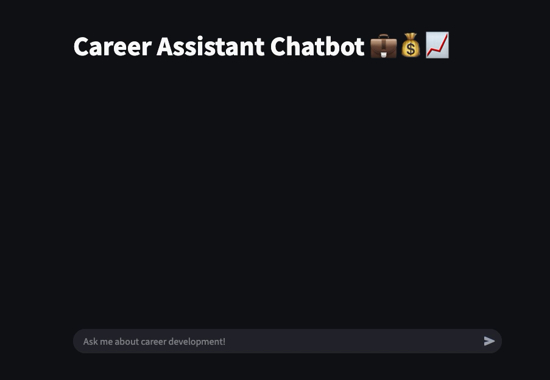
Example conversations
User: 'What skills do I need to be a data scientist?'
Assistant: 'To become a data scientist, you should focus on Python, machine learning, SQL, and data visualization.'
User: 'What certifications should I get to be an HR Coordinator?'
Assistant: ‘To be an HR Coordinator, consider certifications like SHRM-CP, PHR, or HR Analytics.'
Notes:
Now, instead of just telling you how the Career Assistant Chatbot works, let me show you. Here’s a quick demonstration of the chatbot in action.
As you can see, the chatbot provides real-time responses to career-related questions. It processes user queries efficiently and delivers clear, informative, and personalized answers.

Slide 7

Future enhancements
Expanding the knowledge base with more industry-specific advice.
Enhancing personalization based on user preferences.
Integrating with career platforms like LinkedIn.
Notes:
While the chatbot works at the simplest level, there are some exciting improvements planned for the future:
We aim to expand the knowledge base to provide even more industry-specific advice.
The chatbot will be enhanced to offer personalized recommendations based on user interactions.
Future versions may integrate with career platforms like LinkedIn to offer job suggestions.
We are also exploring the possibility of adding voice-based interaction, making the chatbot even more accessible for users who prefer speaking over typing.

Slide 8

Conclusion
The Career Assistant Chatbot is an AI tool for career development.
It provides tailored guidance on skills, certifications, and career paths.
Future enhancements will further improve user experience and accuracy.
Notes:
To wrap things up:
The Career Assistant Chatbot is an AI-powered tool that provides personalized career guidance.
It helps users understand the skills, certifications, and strategies needed for different job roles.
It is designed for students, job seekers, professionals, and HR teams looking to improve career planning.
And with future enhancements, it will become even more intelligent and useful. Thank you for your time!

